Slide 1
Partial splenetomy
Dr.Alaa A. Ibrahim
Department of veterinary surgery and obstetric

Slide 2
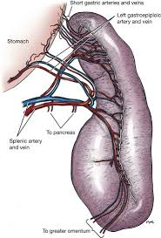
SURGICAL ANATOMY
The spleen is situated in the left cranial abdominal quadrant.
It usually lies parallel to the greater curvature of the stomach
The spleen is lie in rib cage when the stomach is contracted and lie in the caudal abdomen with massive gastric enlargement
The splenic capsule is composed of elastic and smooth muscle fibers

Slide 3
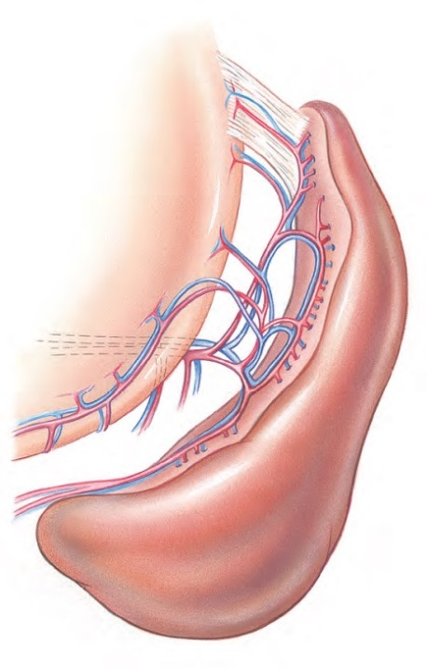
The parenchyma consists of:-
1- white pulp (i.e., lymphoid tissue)
2- Red pulp (i.e., venous sinuses and cellular tissue filling the intravascular spaces)
The arterial supply of the spleen usually is the splenic artery, a branch of the celiac artery.
Venous drainage
occurs via the splenic vein into the gastrosplenic vein, which empties into the portal vein.

Slide 4
Functions of the spleen
Mainly acts as a filter for purifying the blood,
Removing microbes and worn out or damaged red blood cells.
It is also an important organ in the immune system, producing the white blood cells that fight infection and synthesize antibodies.
The spleen is not vital to survival and it is possible to live without a spleen. Without the spleen, other organs in the body (particularly the liver) adapt and increase their ability to fight infection and remove redundant red blood cells.

Slide 5
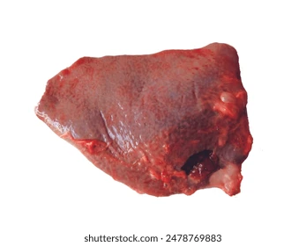
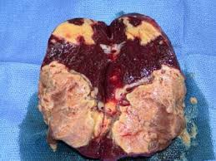
Indications of partial splenectomy
Traumatic lesion of the spleen
Focal lesion of spleen such as abscess

Slide 6
Surgical technique
The spleen is approached via a ventral midline abdominal
incision that extends from the xiphoid to a point caudal to
the umbilicus.
The incision may need to be lengthened for large lesions or to allow complete abdominal exploration
Define the area of the spleen to be removed and double ligate and incise the hilar vessels supplying the area
Note the extent of ischemia that develops, and use this as a guideline for the resection
Squeeze the splenic tissue at this line between a thumb and forefinger, and milk the splenic pulp toward the ischemic area.
Place forceps on the flattened portion, and divide the spleen between the forceps.

Slide 7
Surgical technique
Close the cut surface of the spleen adjacent to the forceps in a continuous pattern using absorbable suture
As an alternative, place two rows of mattress sutures in a continuous overlapping fashion at the line of demarcation.
If hemorrhage continues, oversew the end of the spleen with a continuous suture of absorbable suture material.

Slide 9
Complications of partial splenectomy
Bleeding: most commonly secondary to injury of the splenic capsule or short gastric vessels during mobilization.
Injury to surrounding structures: the structures most commonly injured during splenectomy include the stomach, colon, and pancreas.
Splenic rupture

